Slide 1
Neural Ordinary Differential Equations
Ricky T. Q. Chen*, Yulia Rubanova*, Jesse Bettencourt*, David Duvenaud
Presented by: Zayid Oyelami
Partner: Weijie Gan

Slide 2
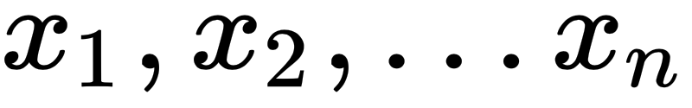
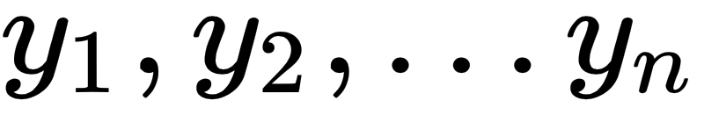
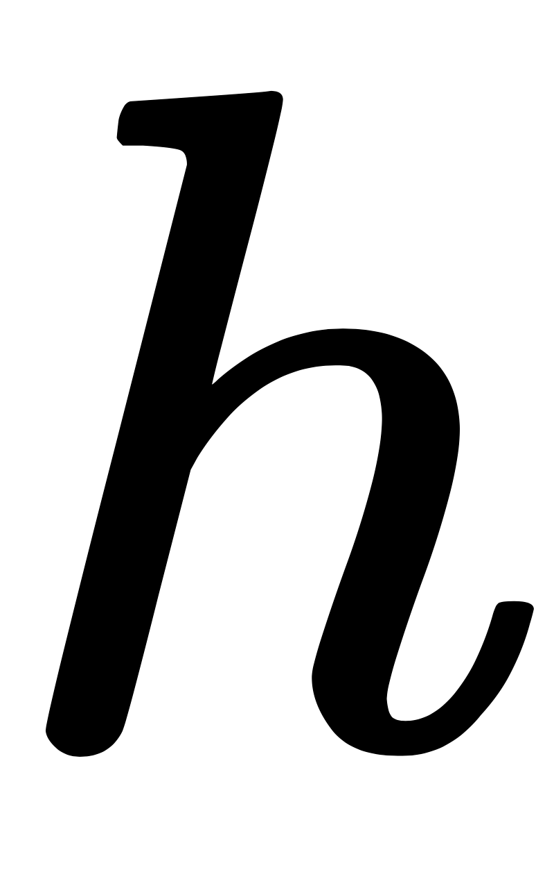
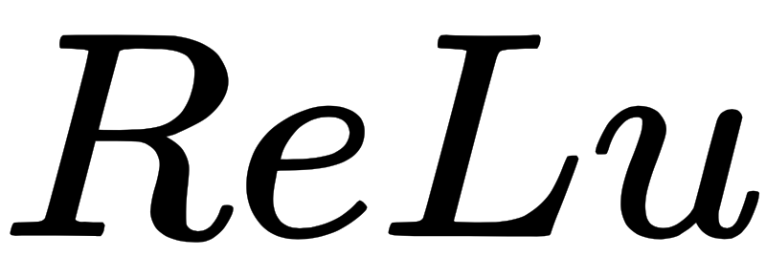


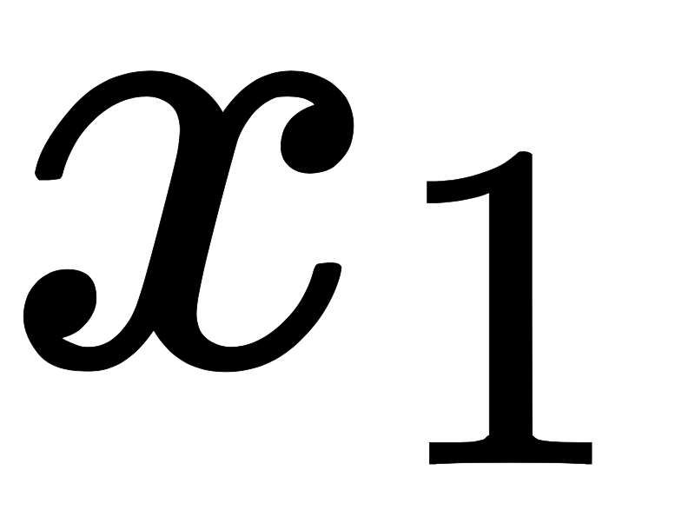
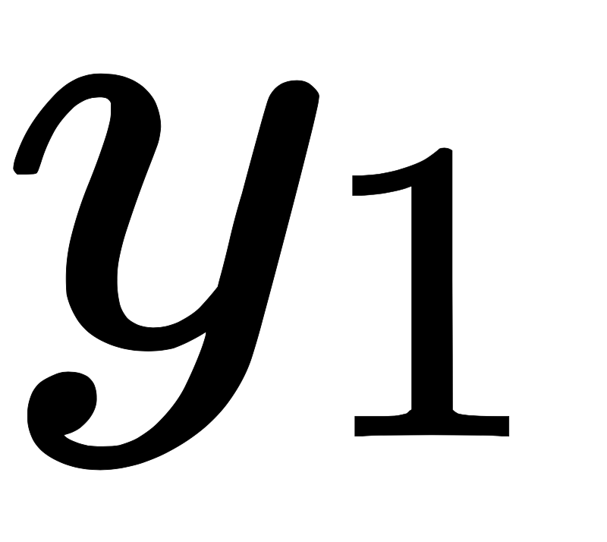
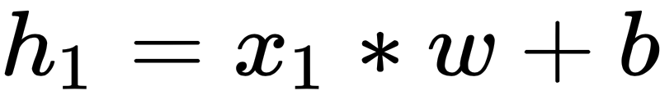
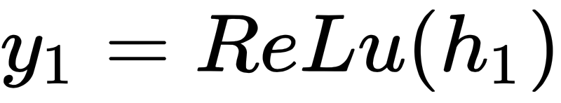
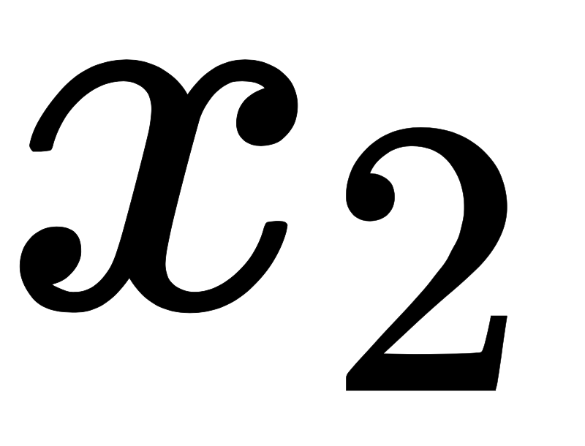
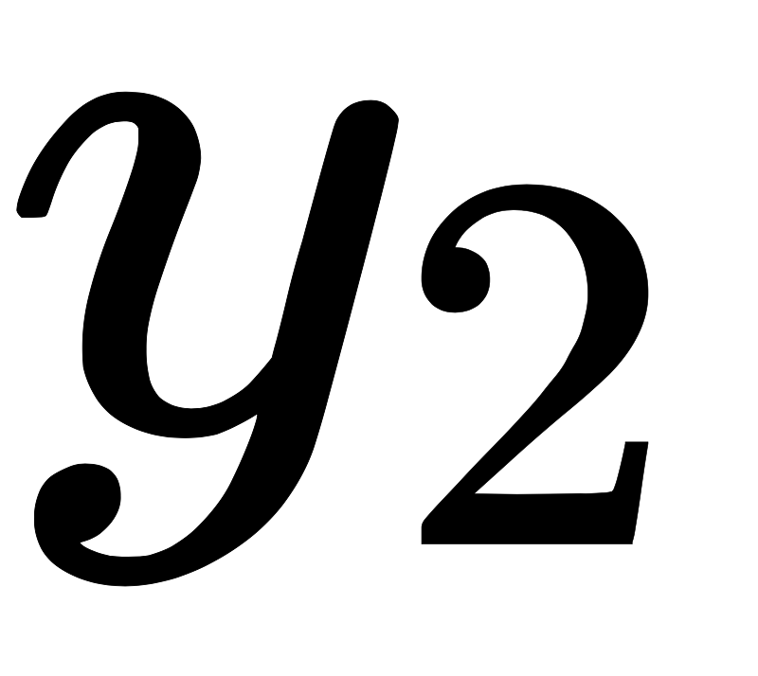
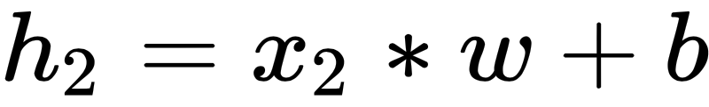
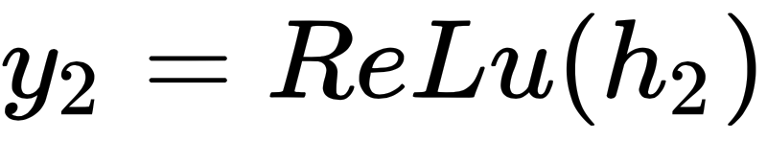
Recall: General Neural Network
are input data. are output data. is hidden layer. Is activation function.
…..

Slide 3
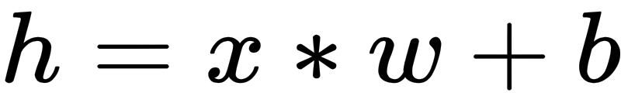
Introduction: Recurrent Neural Network
The Basic Idea of RNN is that the value of hidden layers not only depends on the the value of input but also the value of hidden layers in the last phase. -- Discrete

Slide 4
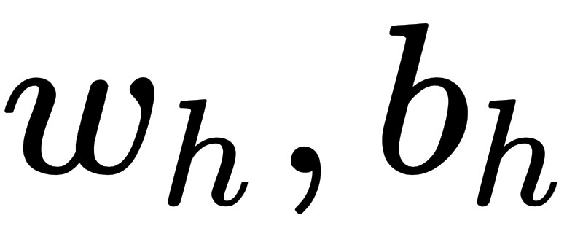
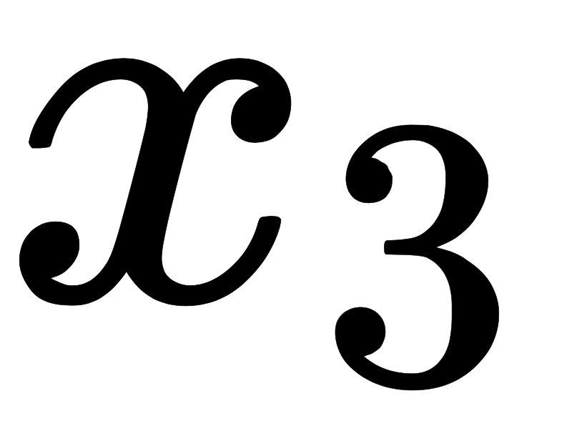
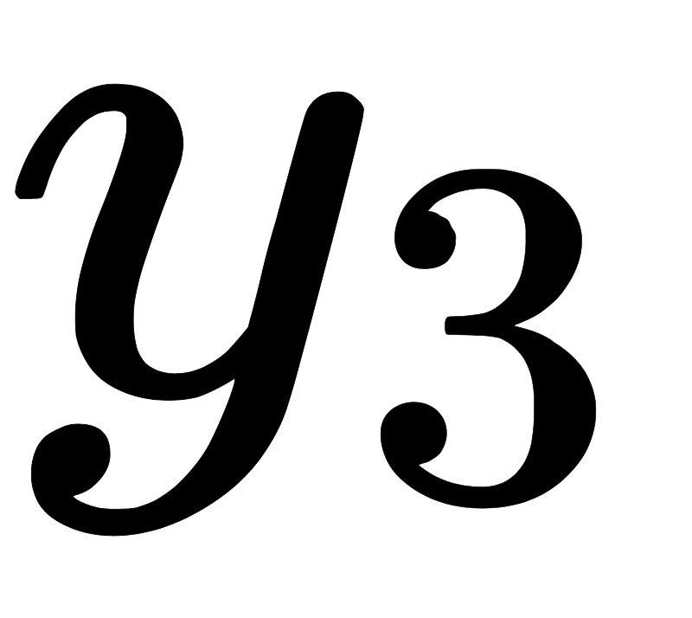
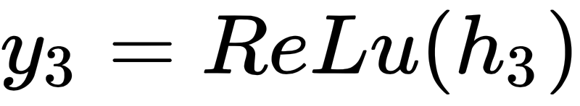
Introduction: Recurrent Neural Network

Slide 5
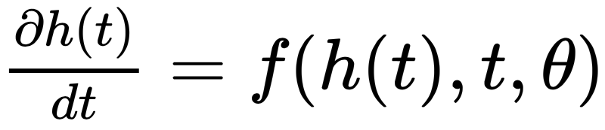
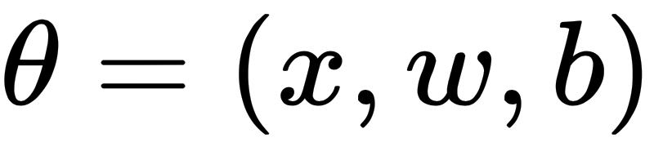

Neural Ordinary Differential Equation
The Basic Idea of Ordinary Differential Equation is the value of hidden layer only depends on a differential equation with phase (time) as variable. -- Continuous
Where and is determined manually.

Slide 6
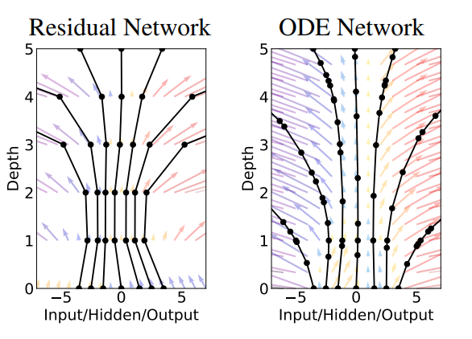
Neural Ordinary Differential Equation
Benefits:
Memory Efficiency
No need to store hidden layer from last phase.
Adaptive Computation
Flexible ways to solve differential equation.
Example: adjoint sensitivity model.
Parameter efficiency
Reduce the number of parameter.

Slide 7
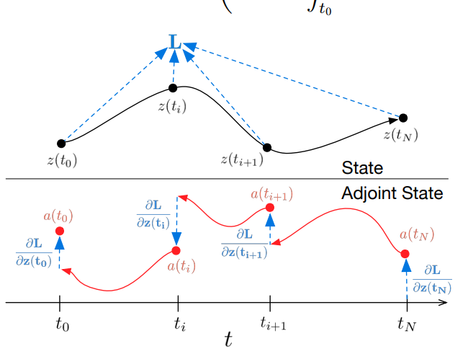
Reverse-mode Automatic Differentiation of ODE Solutions
Treat the ODE solver as a black box
Compute gradients using adjoint sensitivity method

Slide 8


Reverse-mode Automatic Differentiation of ODE Solutions
Optimize Loss Function
Determine how gradient of loss depends on the hidden state z(t) at each point
Computing gradients with respect to 𝚹

Slide 9
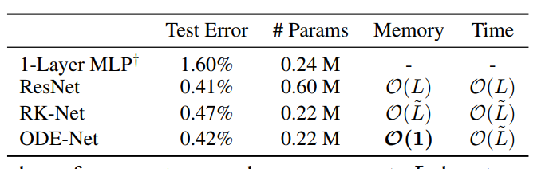
Methods: Supervised Learning

Slide 10
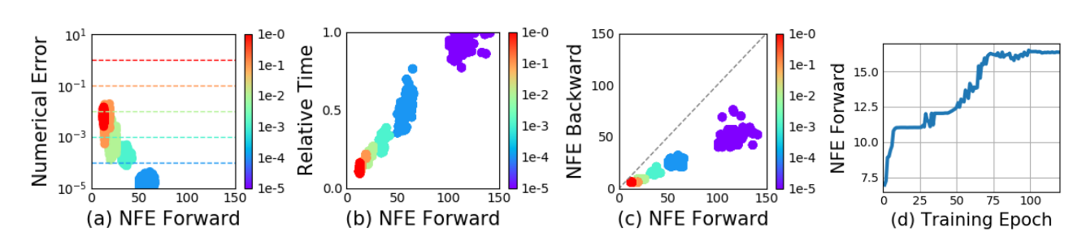
Methods: Supervised Learning

Slide 11
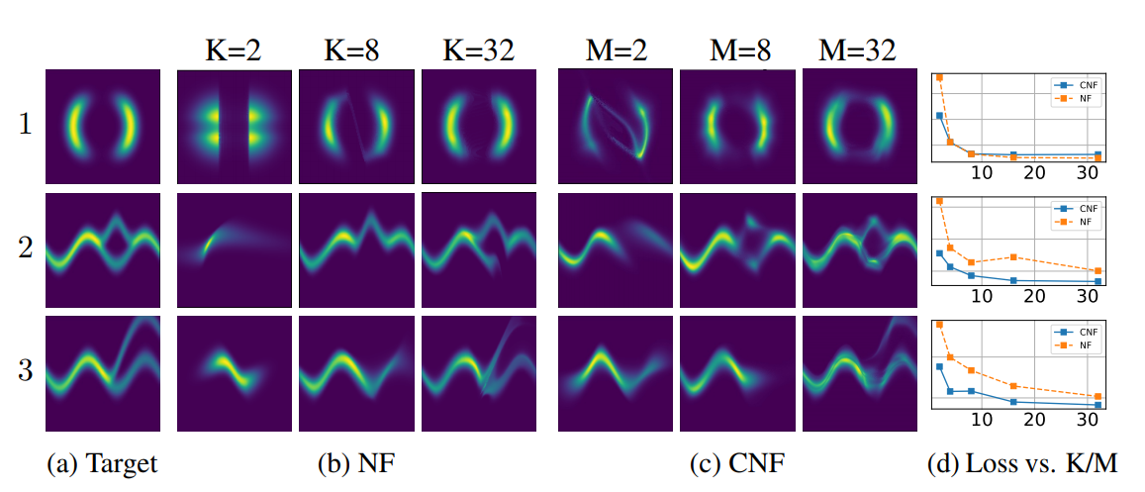
Methods: Continuous Normalizing Flows

Slide 12
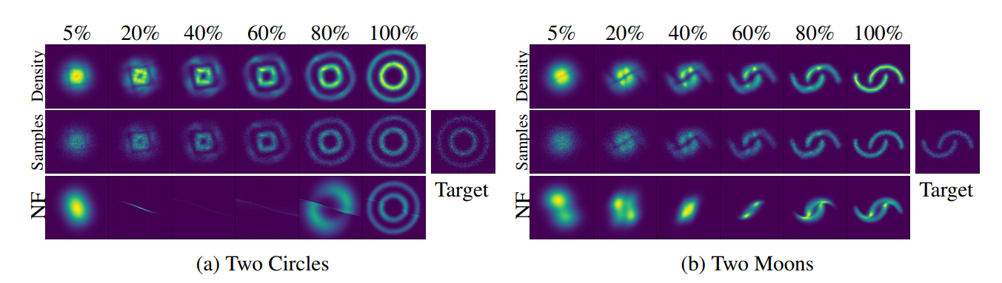
Methods: Continuous Normalizing Flows

Slide 13
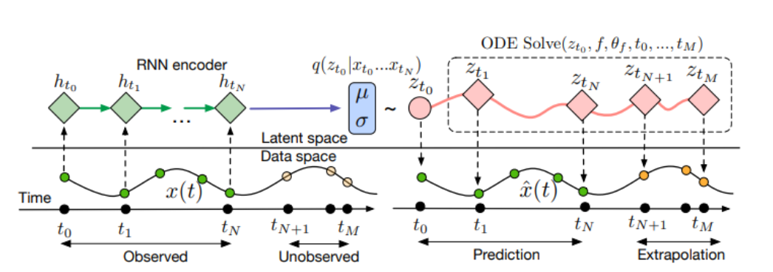
Methods: Generative Latent Function

Slide 14
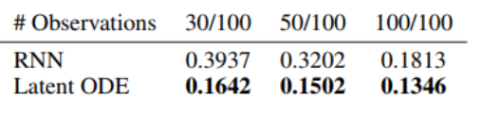
Methods: Generative Latent Function

Slide 15
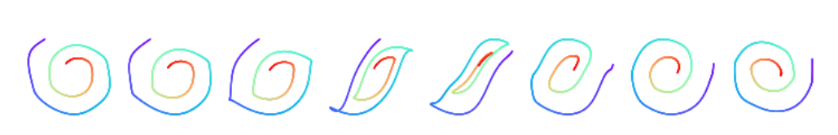
Methods: Generative Latent Function

Slide 16
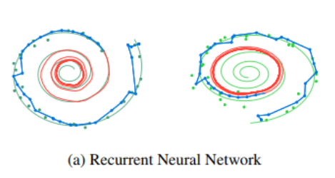
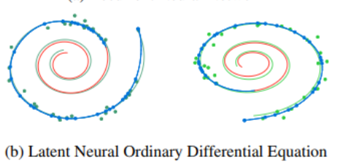
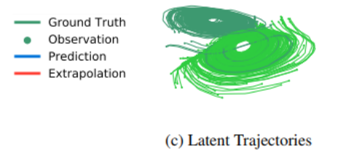
Methods: Generative Latent Function

Slide 17
Discussion
Minibatching:
More complex mini-batching scheme
Uniqueness:
Picard’s Existence Theorem
Setting Tolerances:
Reducing tolerance without degrading performance
Reconstructing Forward Trajectories
Checkpointing - Storing intermediate values of z on the forward pass & reconstructing the exact forward trajectory by re-integrating from those points

Slide 18
Related Work / Potential Directions
Adaptive Computation.
Trained a secondary neural network to choose the number of evaluations of recurrent or residual network. It increases complexity while this method does not. [1, 2, 3, 4]
Constant Memory Backprop through Reversibility.
Developed reversible versions of residual networks which give the the same constant memory advantages as this method and at the same time, restricts architectures of network. [5, 6, 7]

Slide 19
Related Work / Potential Directions
Learning Differential Equations
Training a feed-forward or recurrent neural networks to approximate a differential equation [8]
Gaussian Processes (GPs) and ODE Solvers [9]
Differentiating through ODE Solvers
Dolfin library - implements adjoint computation for general ODE and PDE solutions, but only by backpropagating through the individual operations of the forward solver. [10]
Stan library - implements gradient estimation through ODE solutions using forward sensitivity analysis [11]

Slide 20
Related Work
Papers List:
[1] Adaptive computation time for recurrent neural networks. arXiv preprint arXiv:1603.08983, 2016.
[2] Variable computation in recurrent neural networks. arXiv preprint arXiv:1611.06188, 2016.
[3] Spatially adaptive computation time for residual networks. arXiv preprint, 2017.
[4] Multi-level residual networks from dynamical systems view. In International Conference on Learning Representations, 2018.
[5] Recurrent marked temporal point processes: Embedding event history to vector. In International Conference on Knowledge Discovery and Data Mining, pages 1555–1564. ACM, 2016.
[6] Reversible architectures for arbitrarily deep residual neural networks. arXiv preprint arXiv:1709.03698, 2017.
[7] Reversible architectures for arbitrarily deep residual neural networks. arXiv preprint arXiv:1709.03698, 2017.
[8] Hidden physics models: Machine learning of nonlinear partial differential equations. Journal of Computational Physics, pages 125–141, 2018.
[9] Probabilistic ODE solvers with Runge-Kutta means. In Advances in Neural Information Processing Systems 25, 2014.
[10] Automated derivation of the adjoint of high-level transient finite element programs. SIAM Journal on Scientific Computing, 2013.
[11] The Stan math library: Reverse-mode automatic differentiation in c++. arXiv preprint arXiv:1509.07164, 2015.

